Slide 1




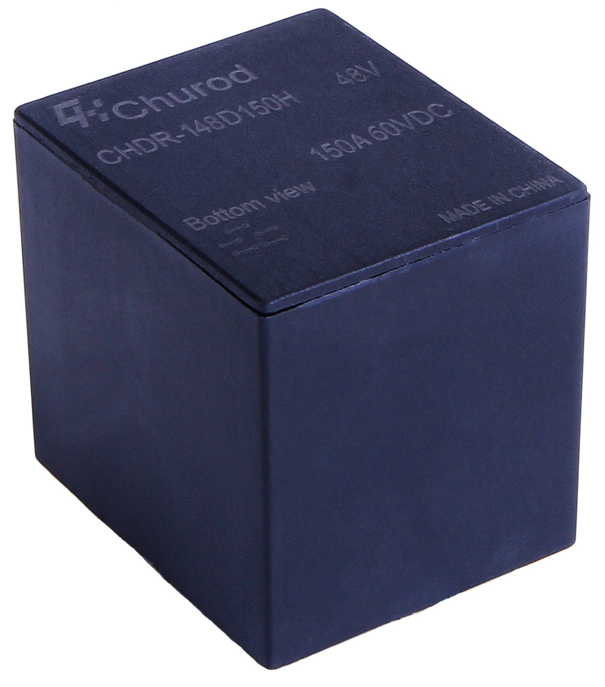
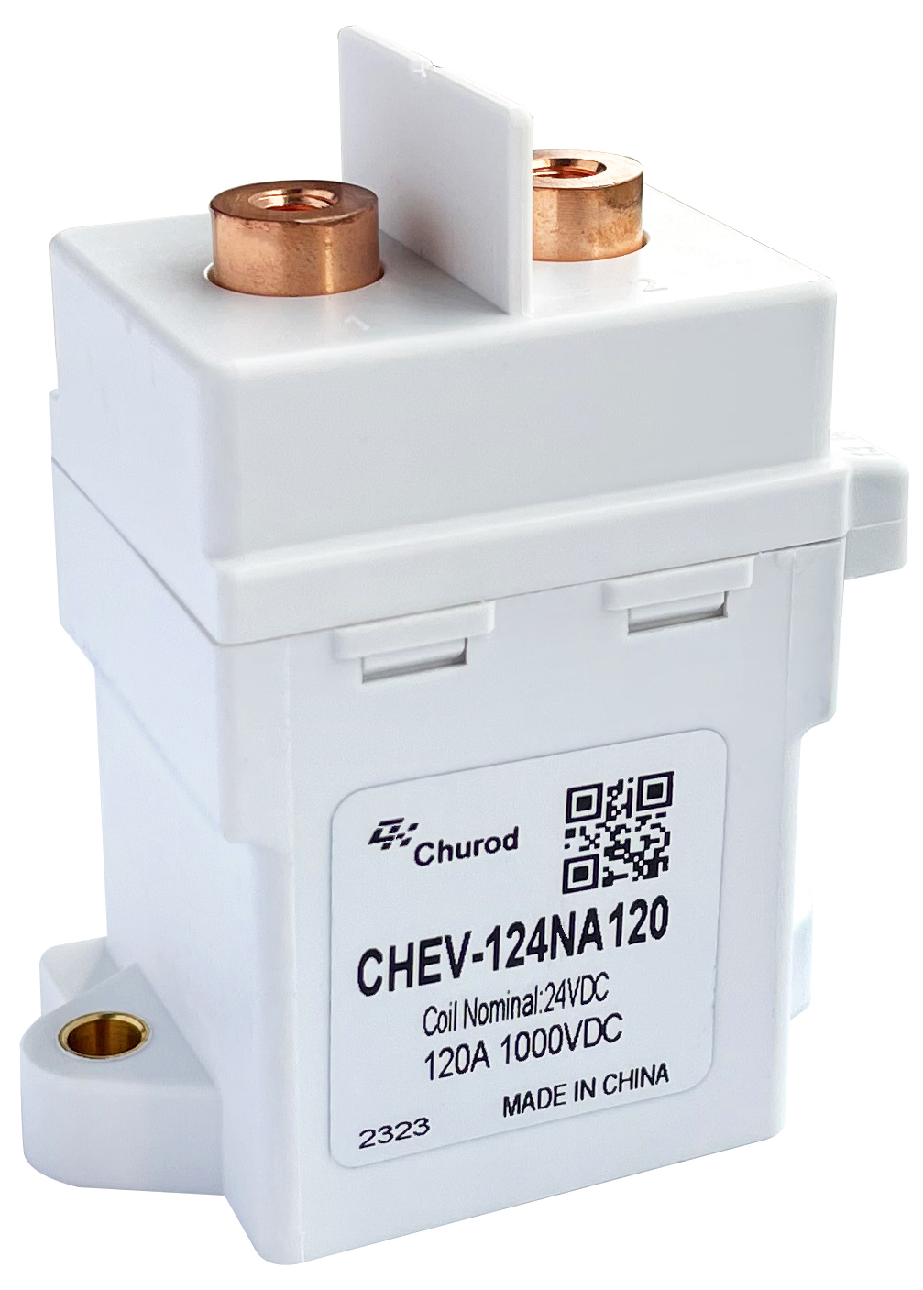
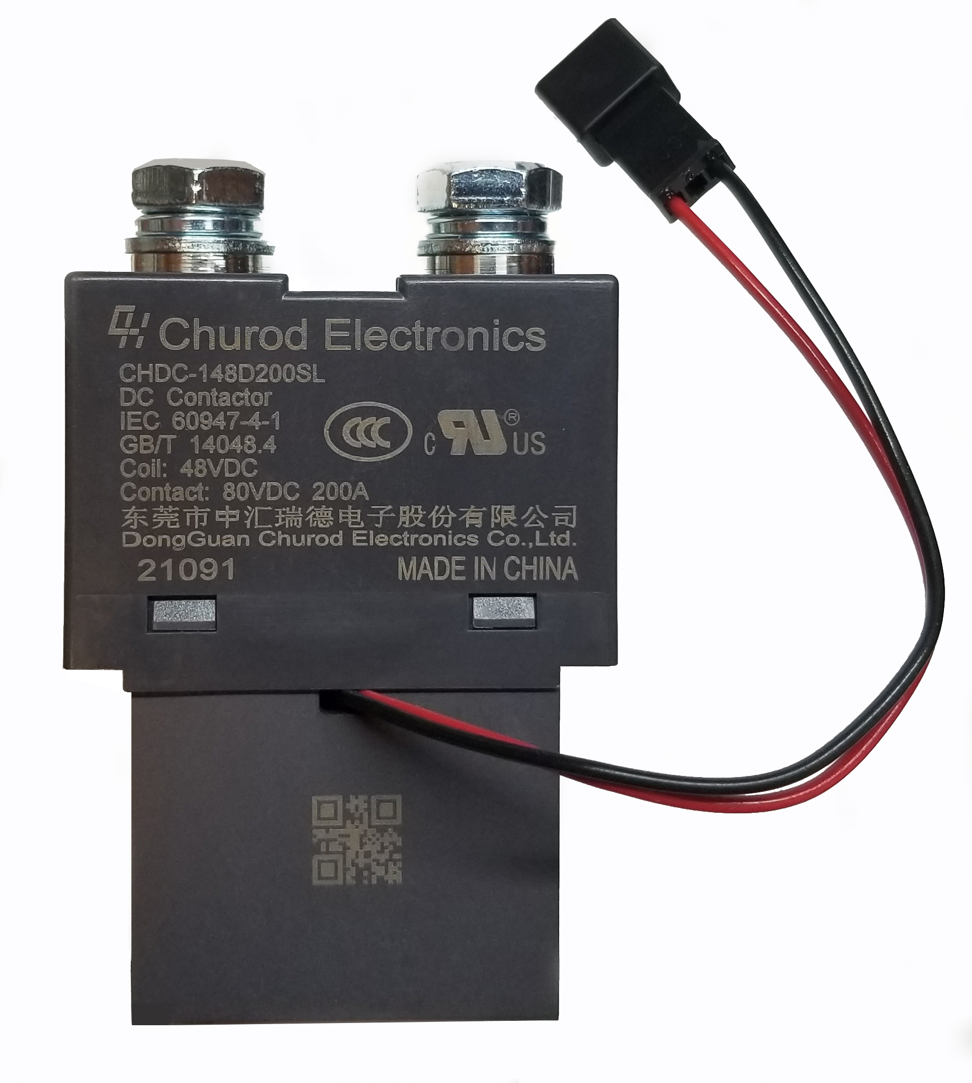
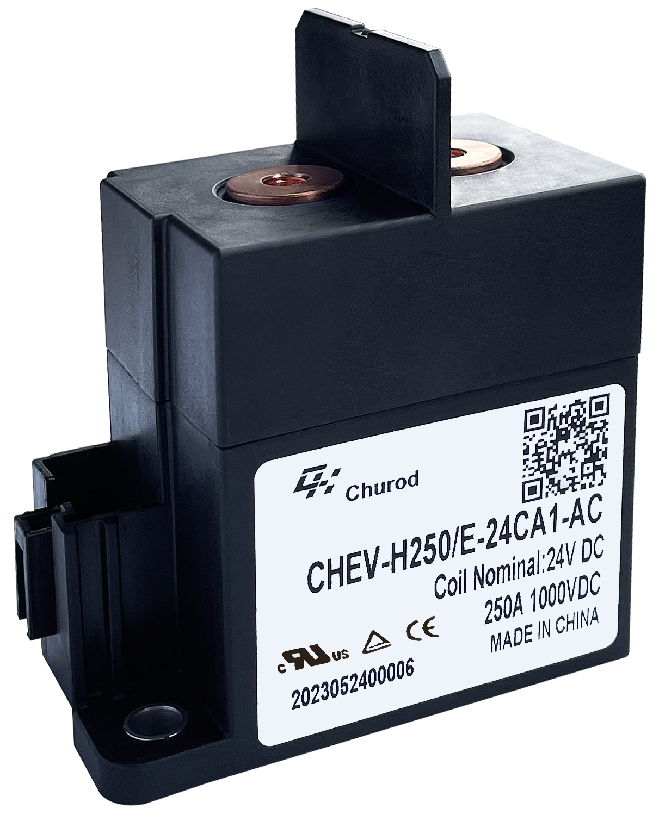
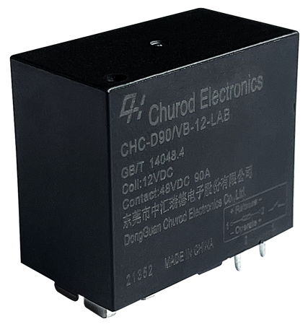
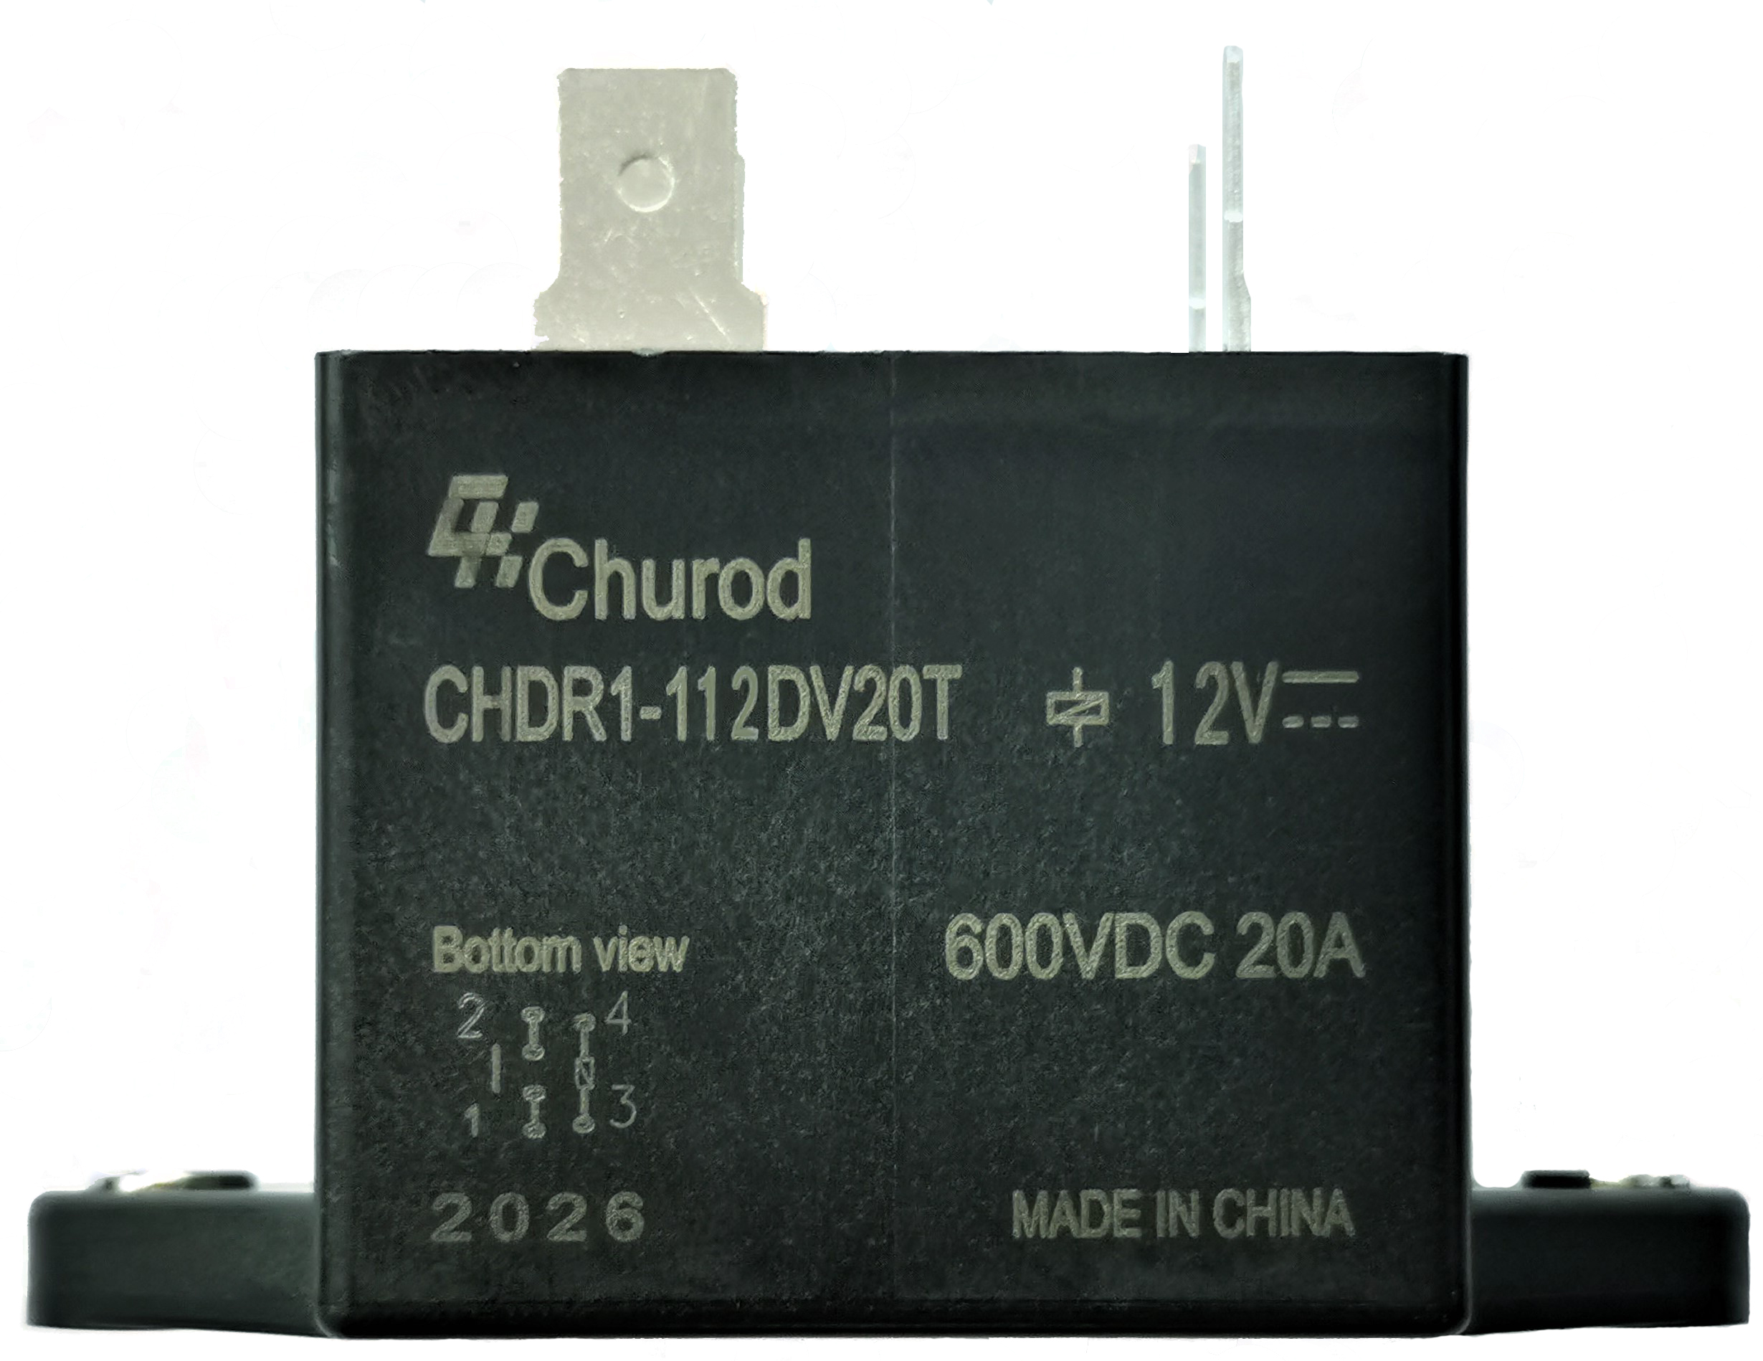
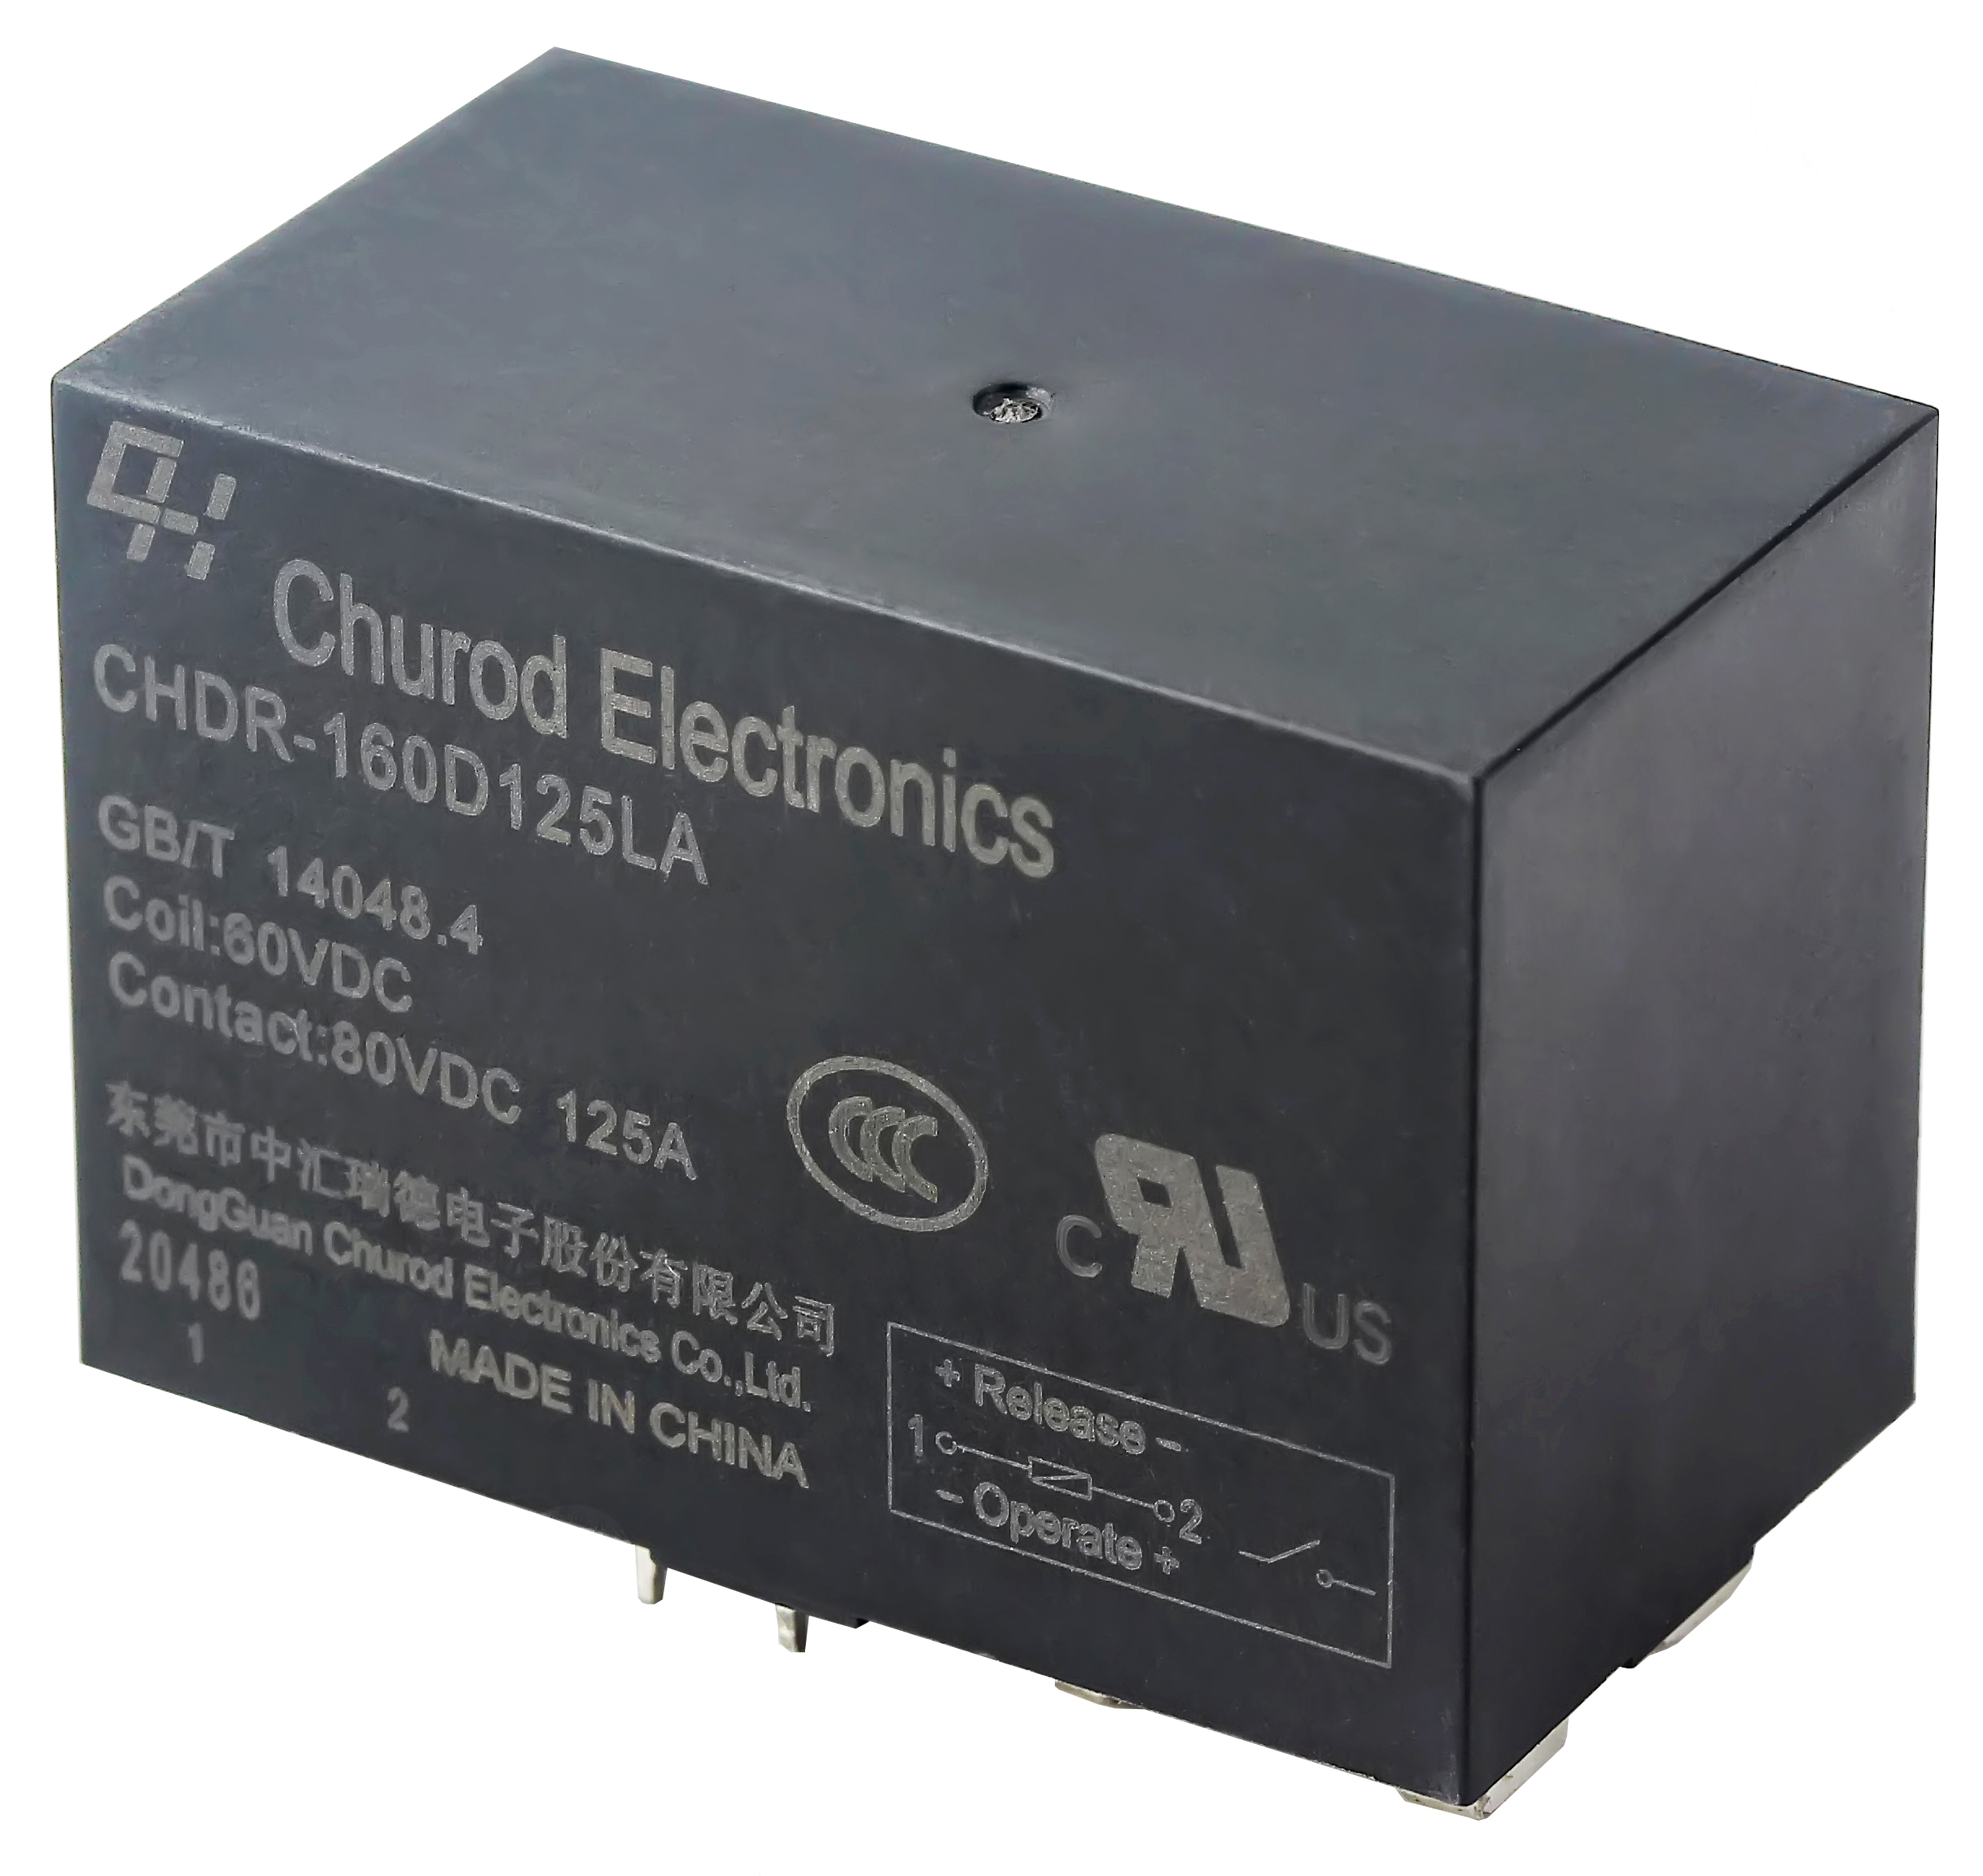
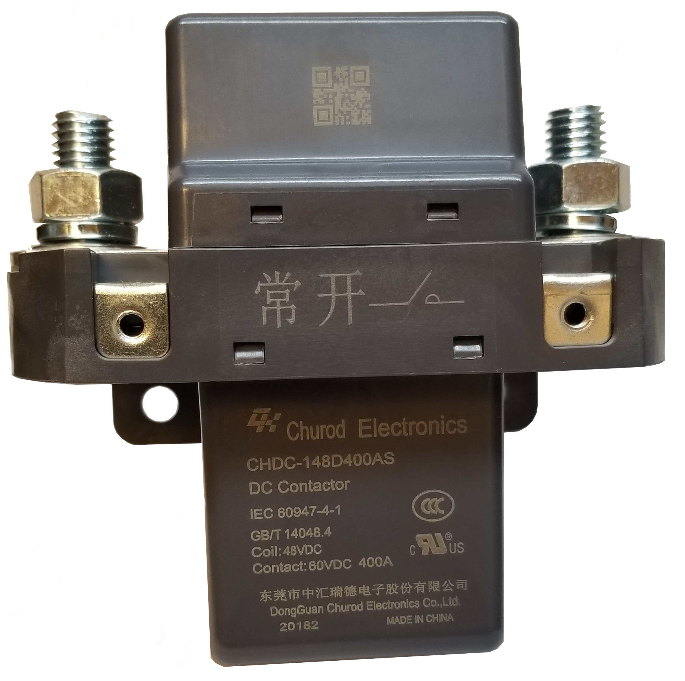
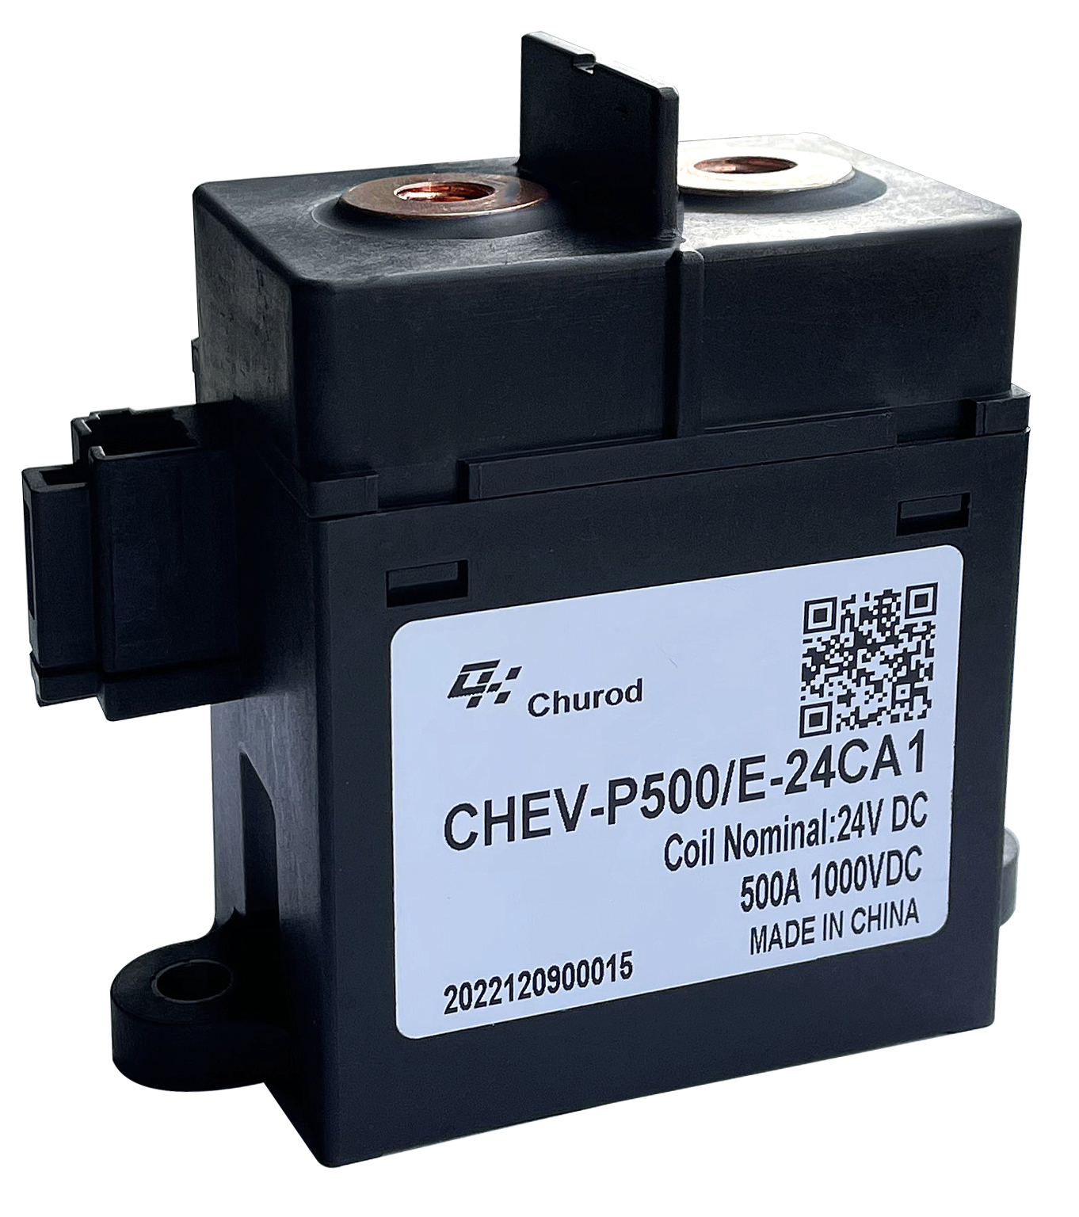
Churod Electronics solutions for forklifts and AGV
Monostable solutions
Latching solutions
CHDR
-100A@48/60VDC
-150A@60VDC
-3.6mm contact gap
CHEV-NA
-60A/120A @1000VDC
-Bi-directional load
-Aux switch standard
CHDC-SL
-200A/400A/500A @80VDC
-Optional aux switch
CHDR1
-20A@600VDC
-50A@500VDC
-3.0mm contact gap
CHEV-H250E
-250A@1000VDC
-Bi-directional load
-Aux switch standard
CHC
-63A/80A @80/60VDC
- 90A@48VDC/250VAC
- Aux switch standard
CHDC
-200A/400A @80/105VDC
CHEV-P500E
-500A@1000VDC
-Bi-directional load
CHDR-L
-80A/110A/125A @24/60/80VDC
-Aux switch standard

